Slide 1

Forests 2020:
Canopy cover estimation based on Support Vector Regression derived from LiDAR & Landsat 8 OLI
Sahid Hudjimartsu, Felliks Tampinongkol, Yudi Setiawan, Lilik Budi Prasetyo

Slide 2
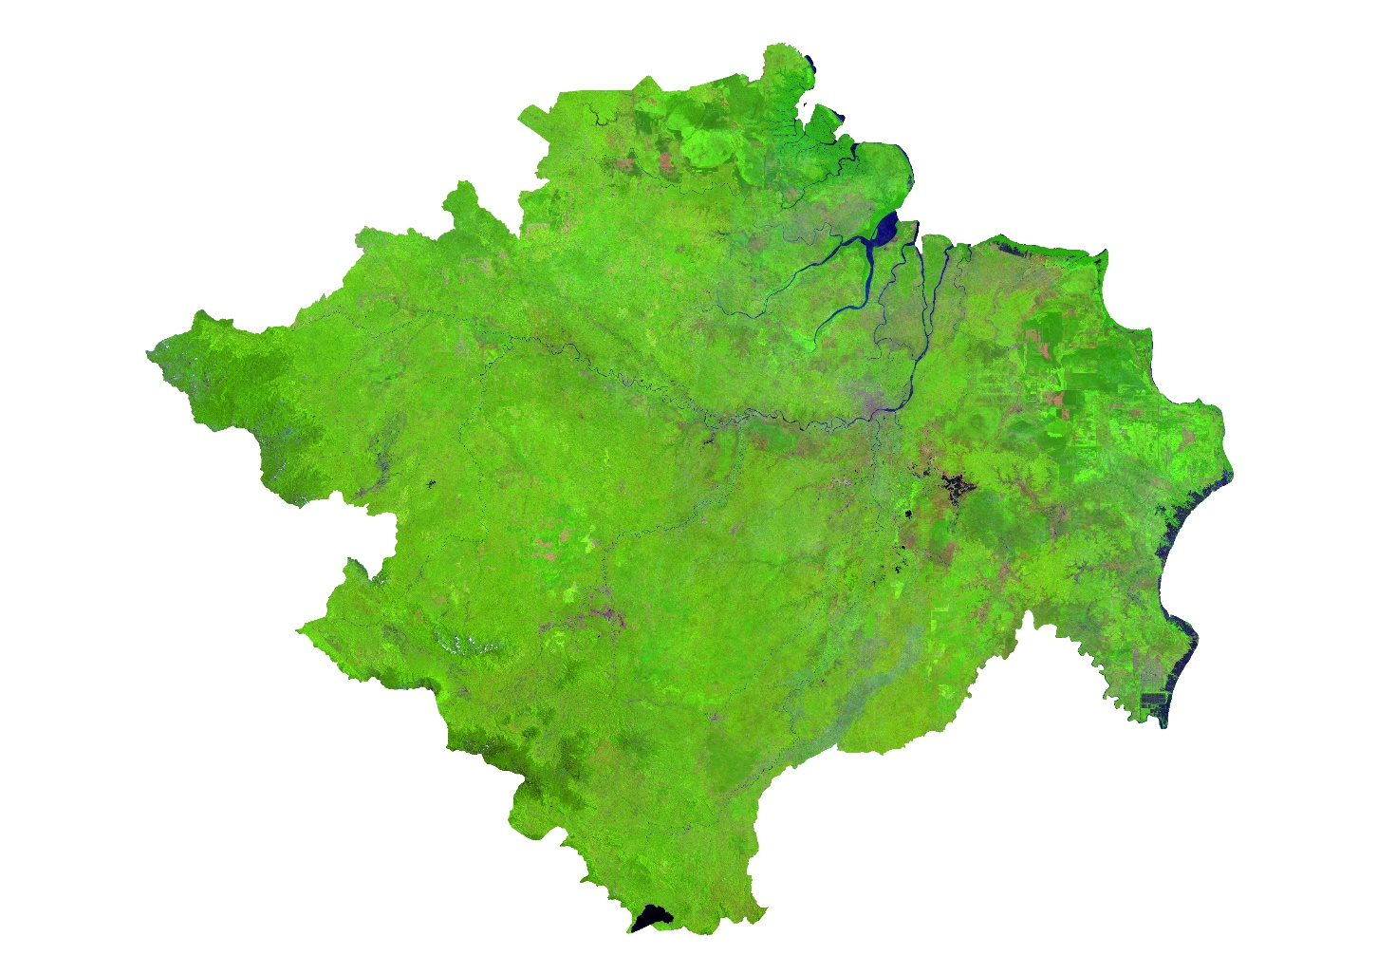
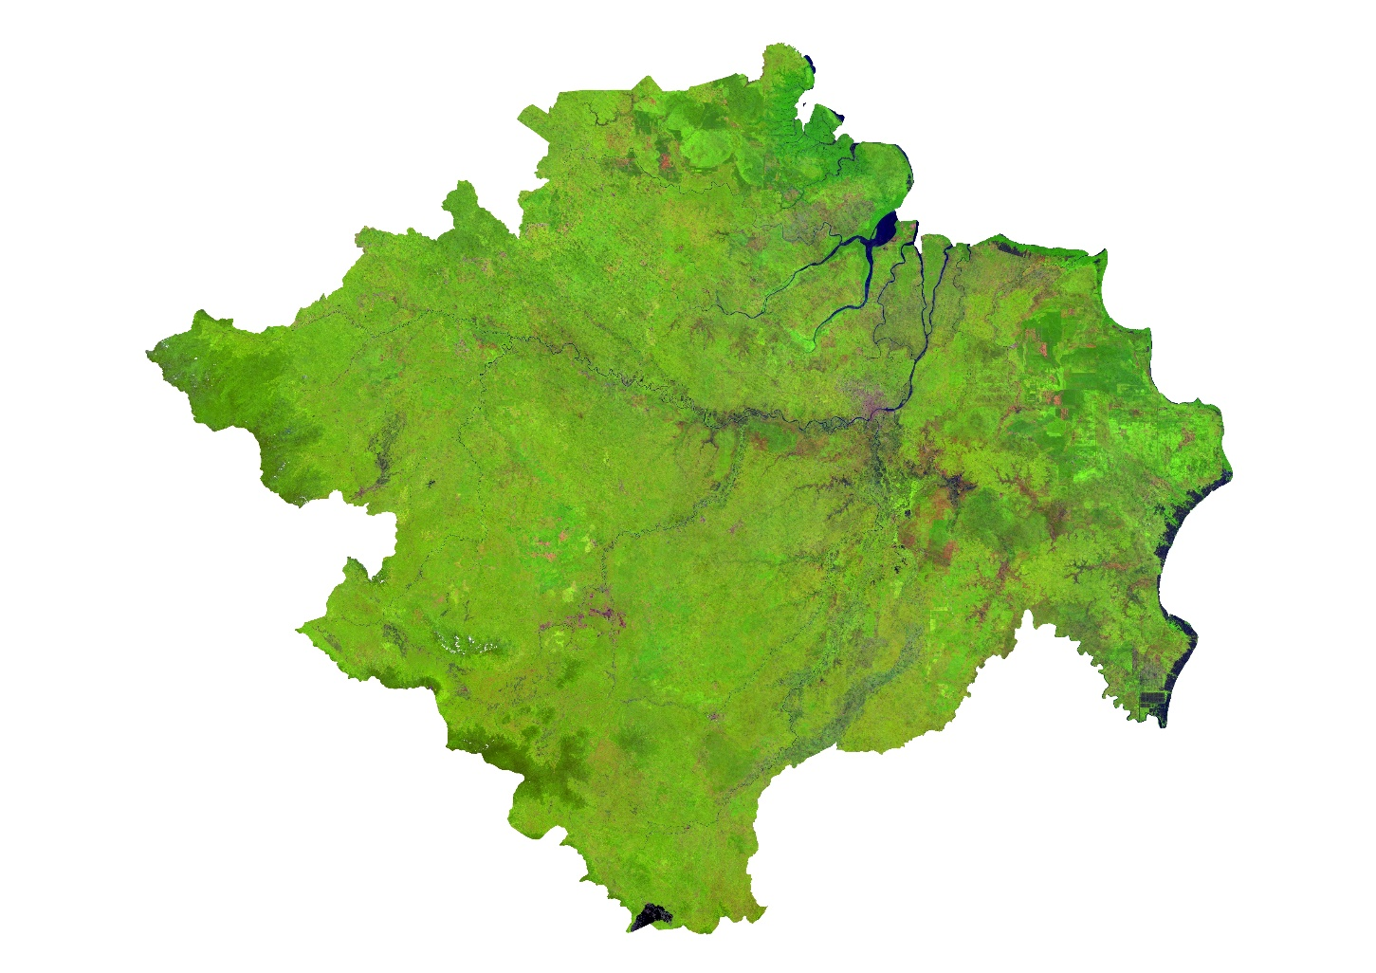
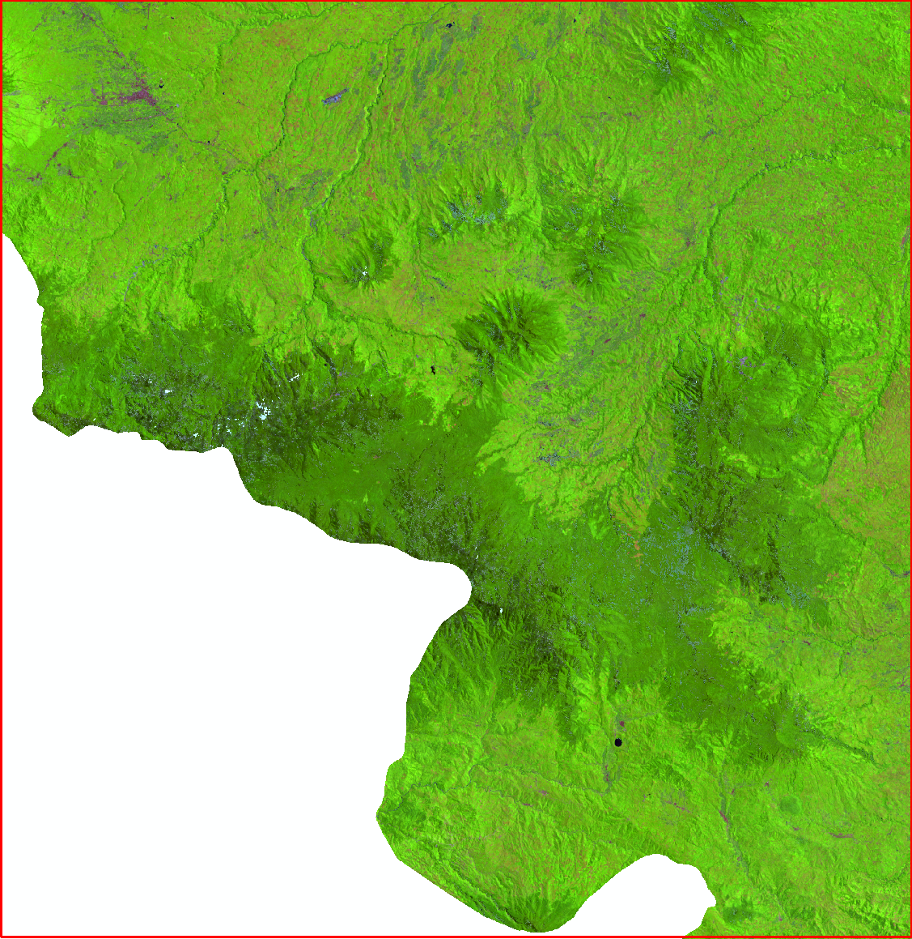
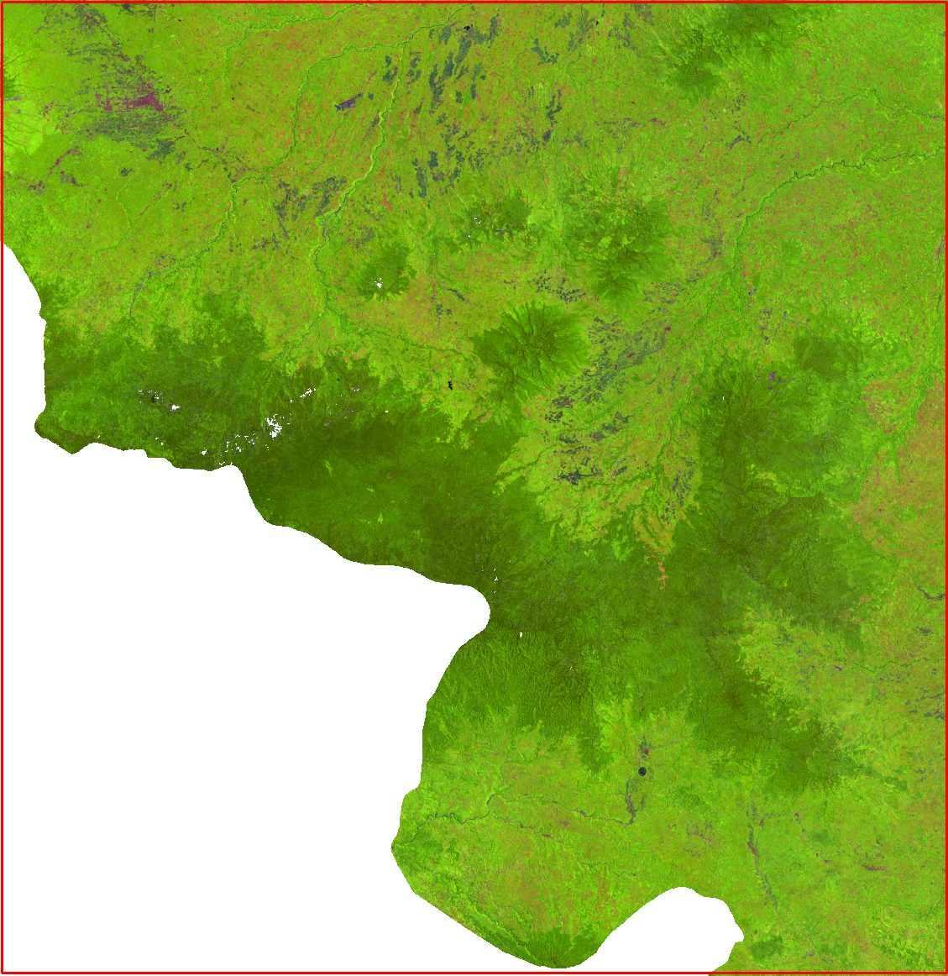
Uncorrected
Corrected

Slide 3
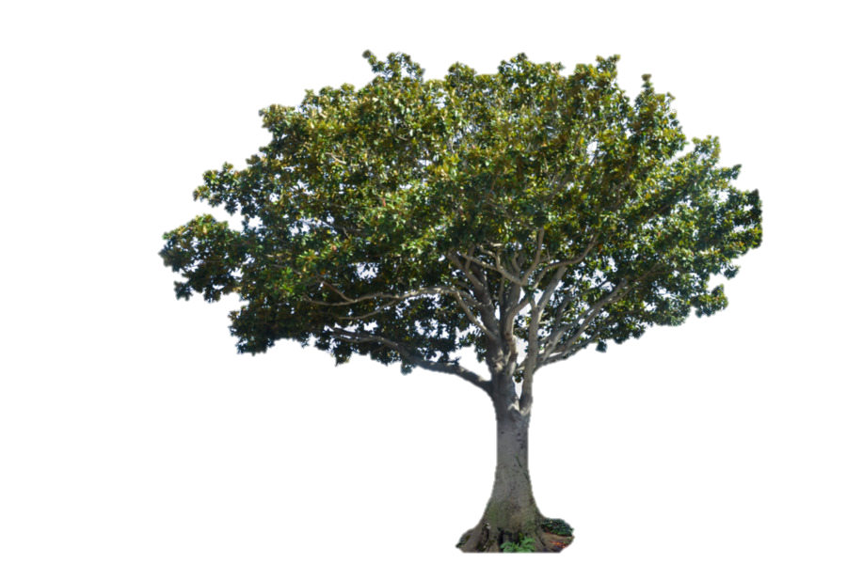
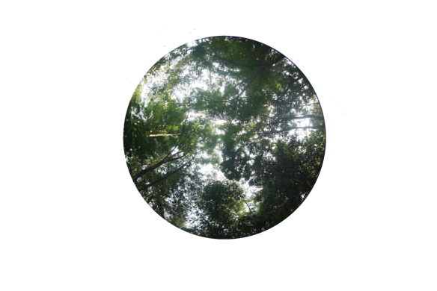


Canopy Cover:
Canopy cover is defined as the percentage of an area occupied by the vertical projection of tree crowns

Slide 4
Indonesian Forests:
Indonesia has many types of forest ecosystem
Ex: peat, swamp, mangrove, tropical rain
This will be a problem in the construction function for National scale using a statistical method, due to many ecosystems and then will have many functions for each ecosystem

Slide 5
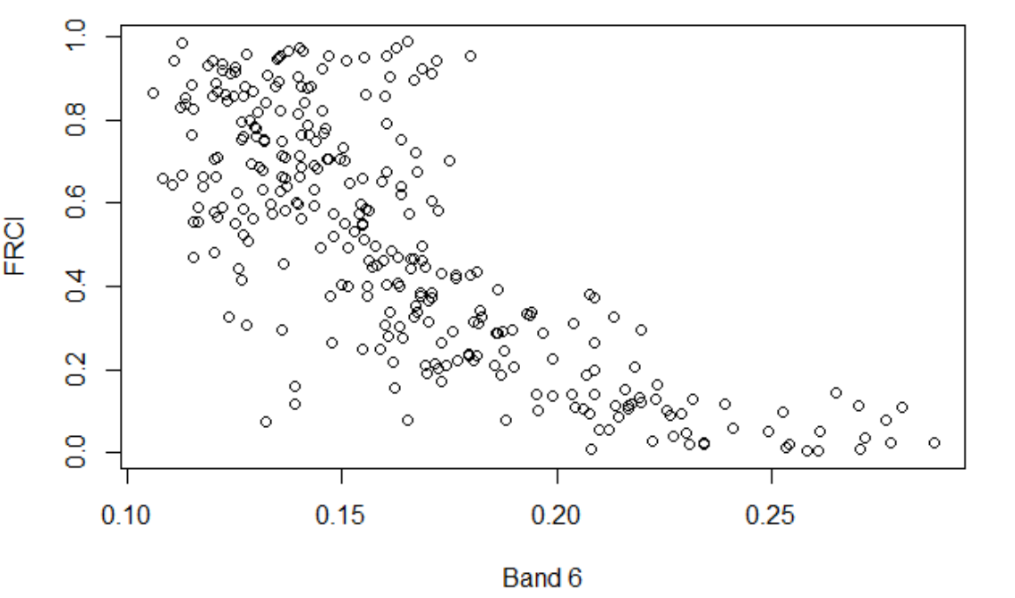
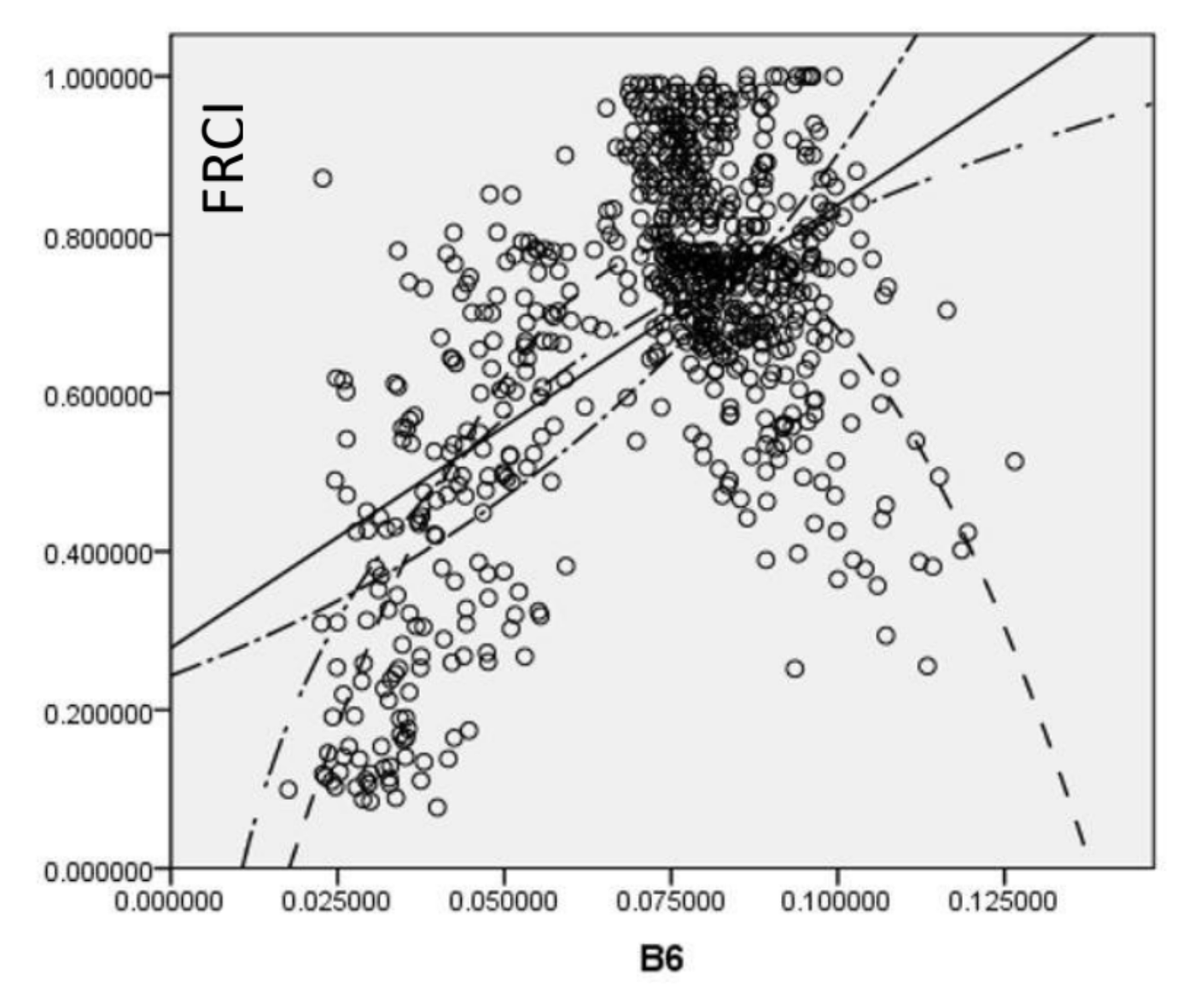
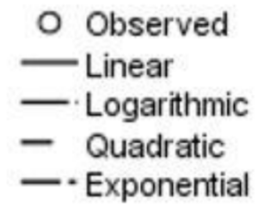
Comparison of the ecosystem response between FRCI and Ref. Band 6
Agroforestry Ecosystem
Mangrove Ecosystem

Slide 6

What is Machine Learning
Machine learning is about the construction and study of systems that can learn from data. This is very different than traditional computer programming.

Slide 7
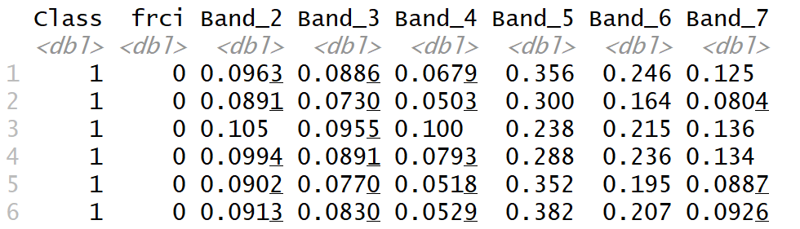

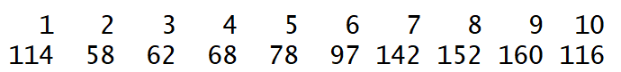
Model Prediction using Support Vector Regression (SVR)…[1]
Sample FRCI data with Landsat 8 Reflectance
Selected data based on stratified class

Slide 8
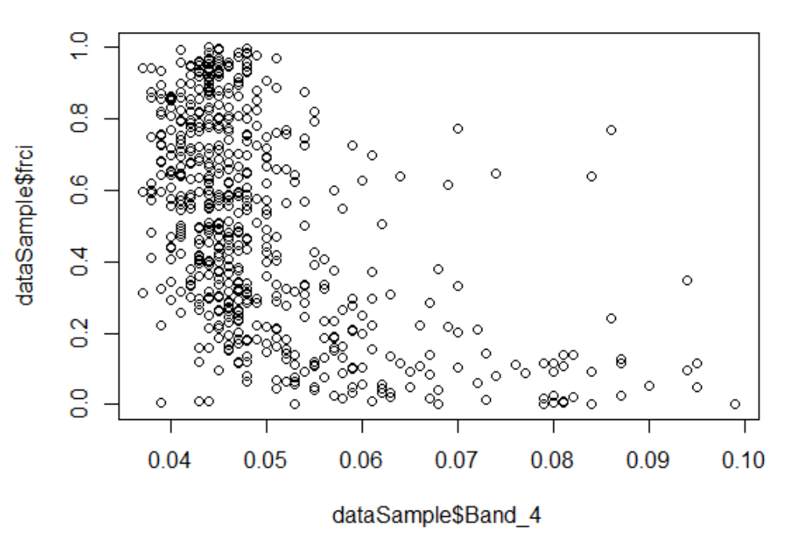
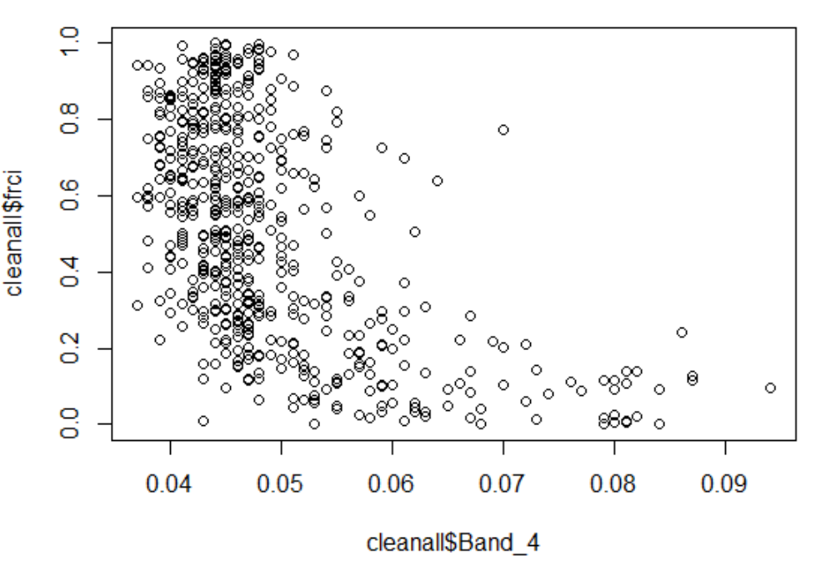

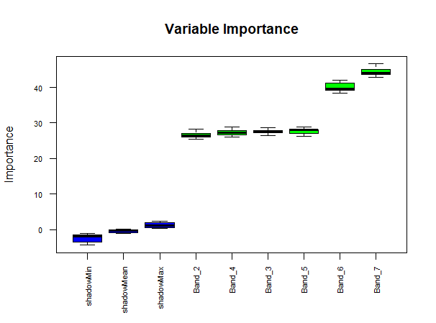
Model Prediction using Support Vector Regression (SVR)…[2]
Before
After
Remove the outlier using DBSCAN Algorithm
Feature Selection using Boruta Algorithm

Slide 9
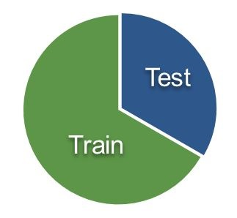
Model Prediction using Support Vector Regression (SVR)…[3]
Divided Data
( Training & Testing Data)
Training Data
Testing Data
Predicted Model
Validation Model
Model Prediction using SVR

Slide 10
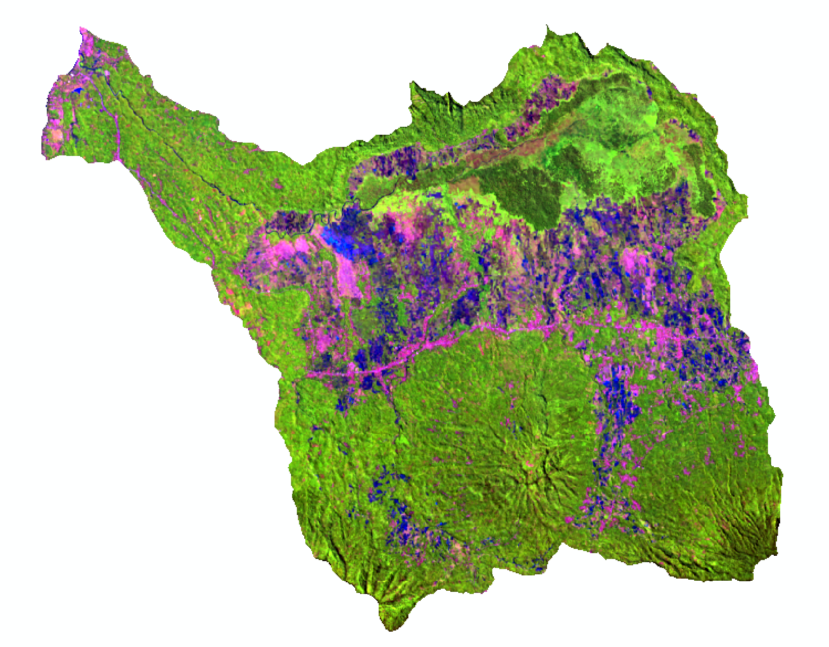
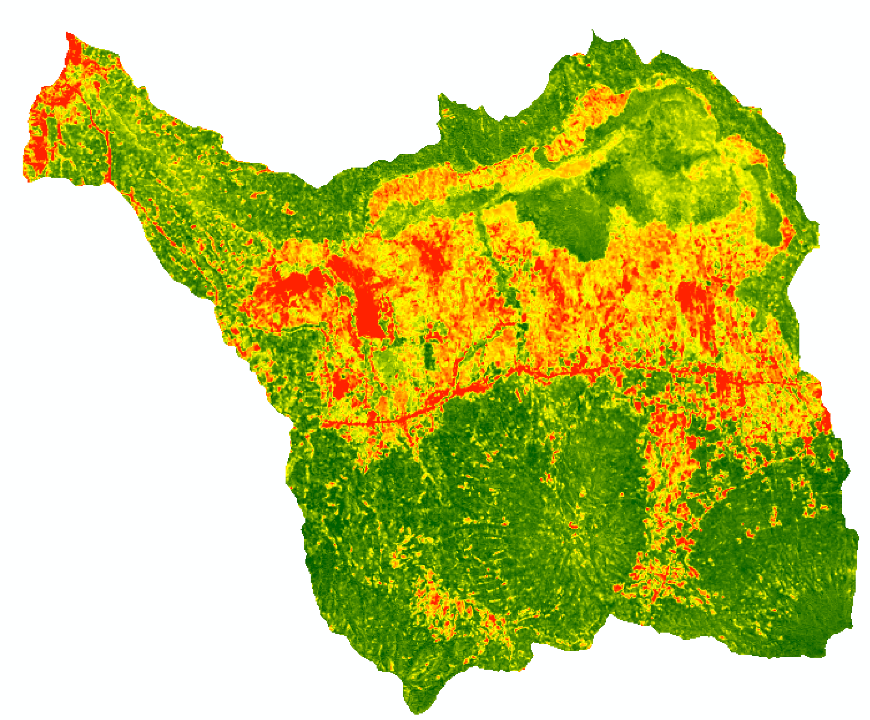
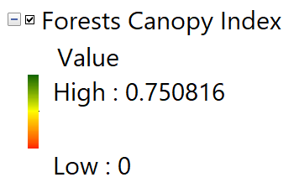
Prediction Model To Estimate Forests Canopy Index Using Support Vector Regression (SVR) in Agroforestry Ecosystem
Landsat 8, Composite 654
Forests Canopy Index

Slide 11
Comparison of Actual and Prediction
RMSE : 0.214

Slide 12
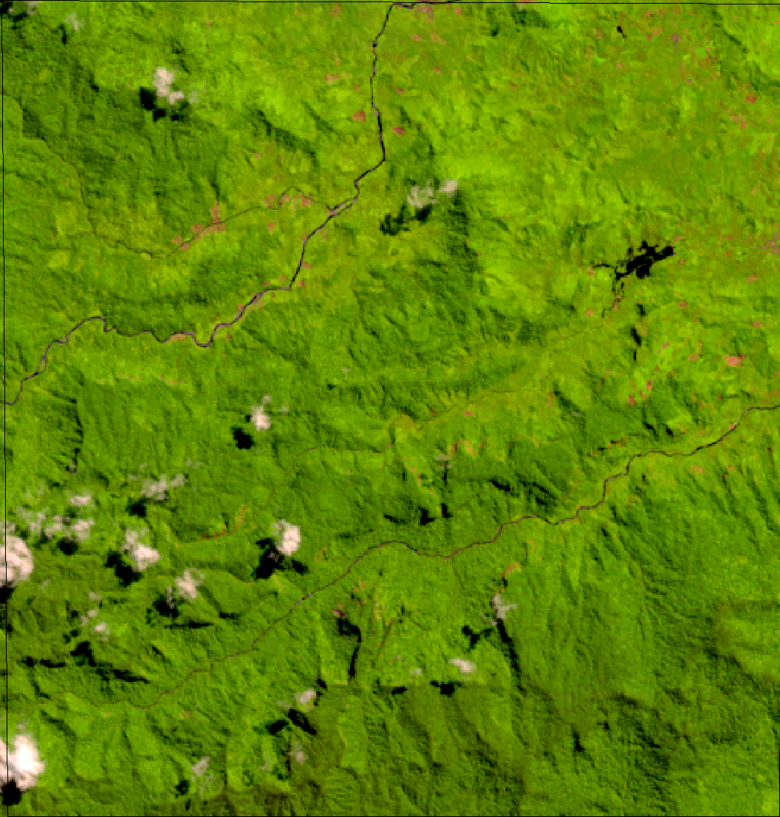
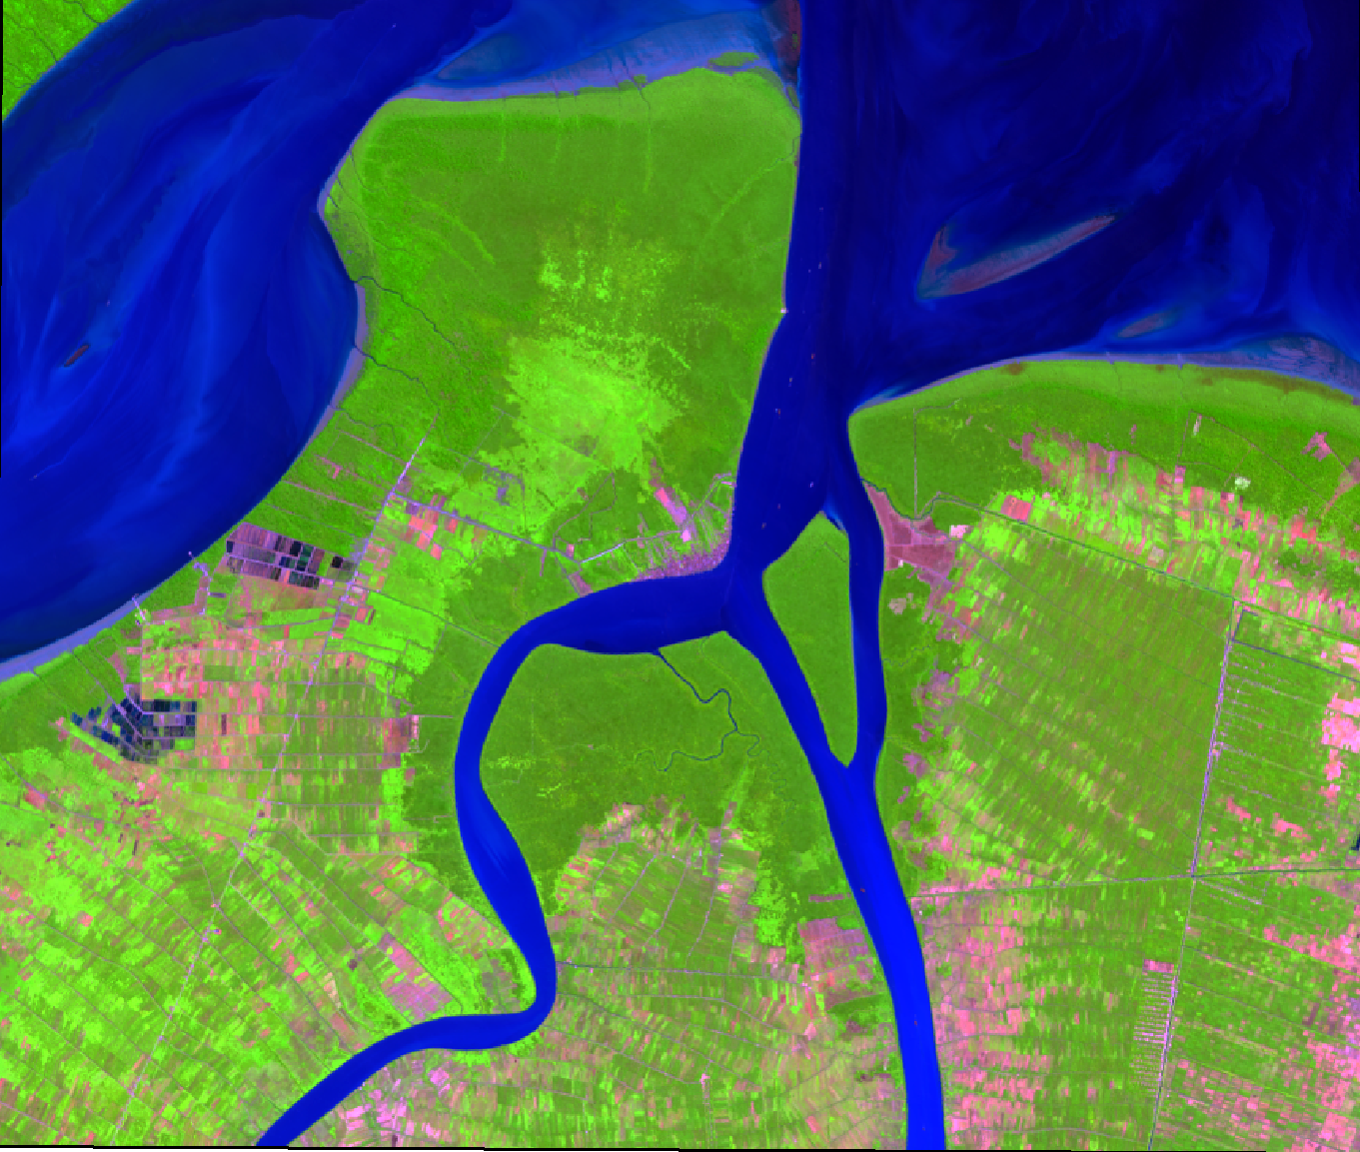
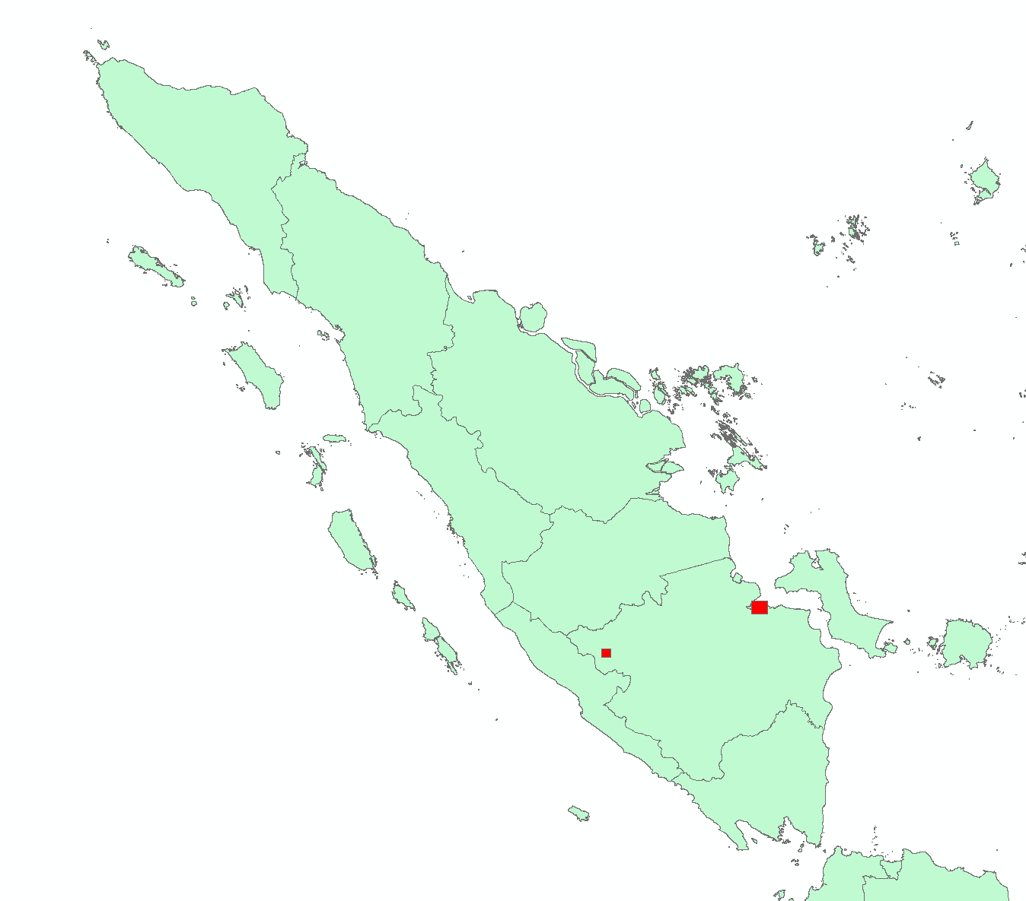
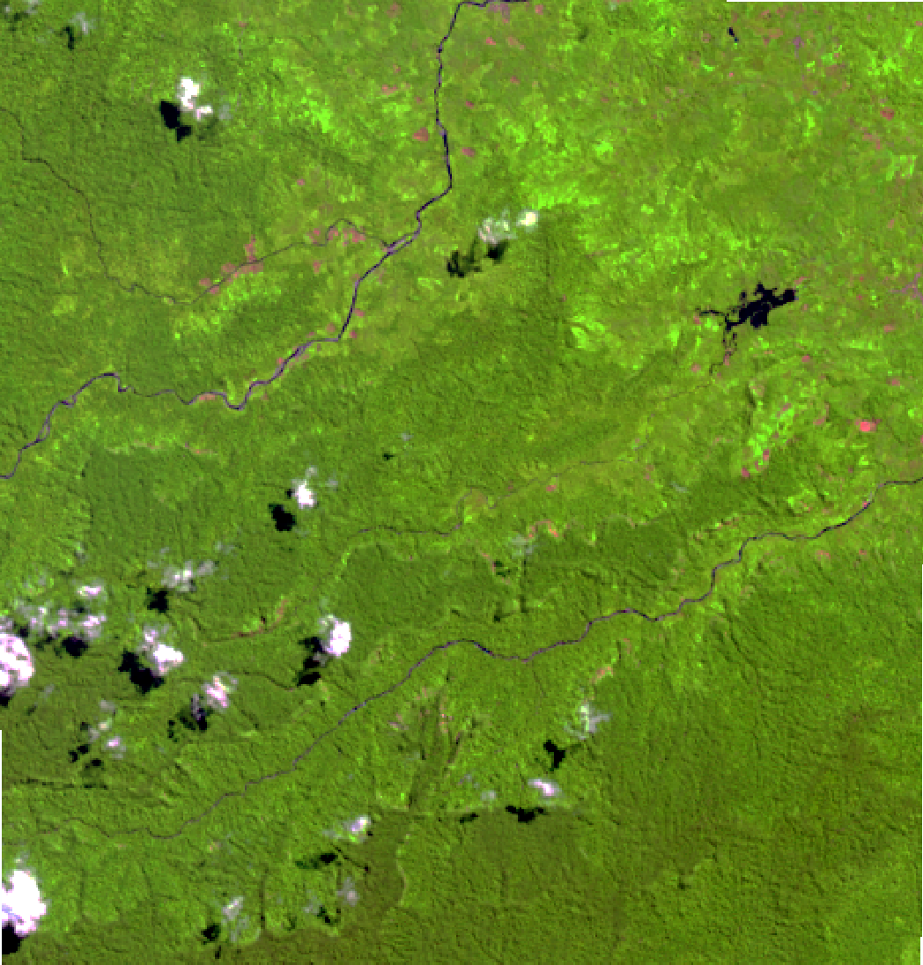
Model Applied to Windows area on Sumatra Island
Uncorrected
Corrected

Slide 13

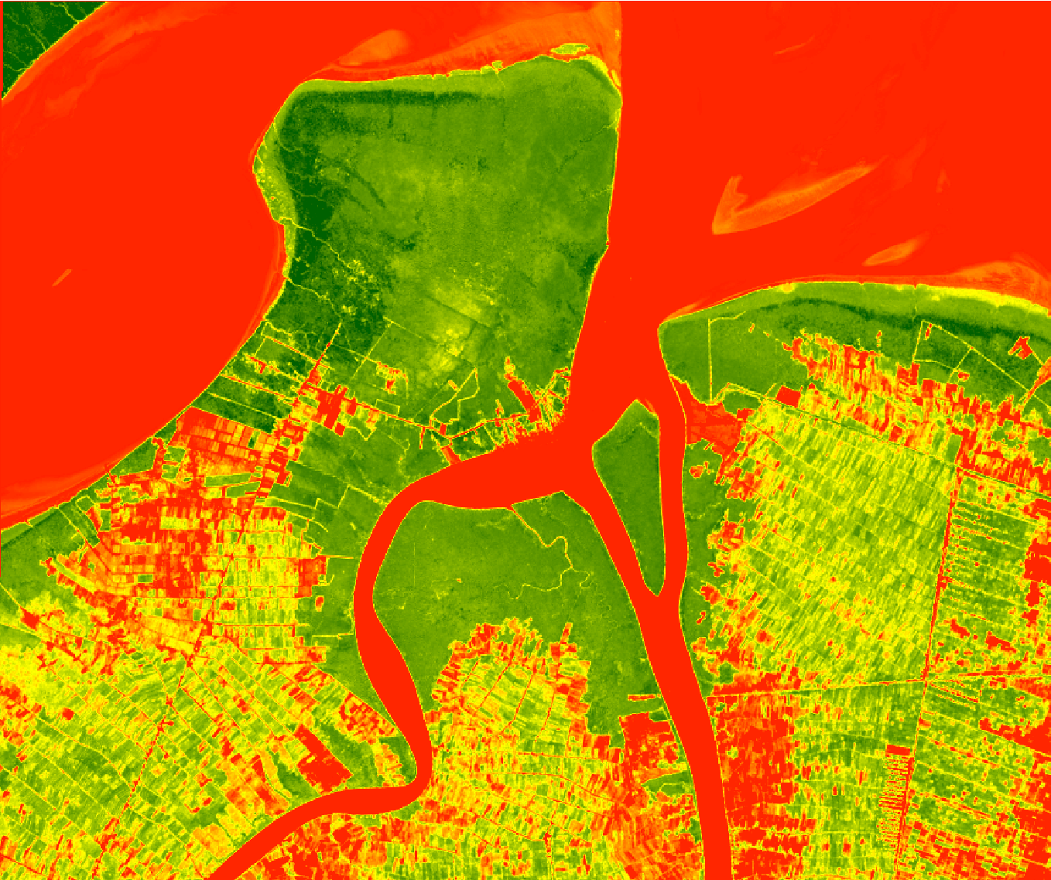
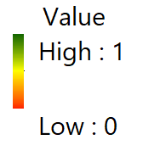
Model Applied to Estimate Canopy Cover in Mangrove Ecosystem

Slide 14
Comparison of FRCI Actual and Prediction
RMSE : 0.271

Slide 15
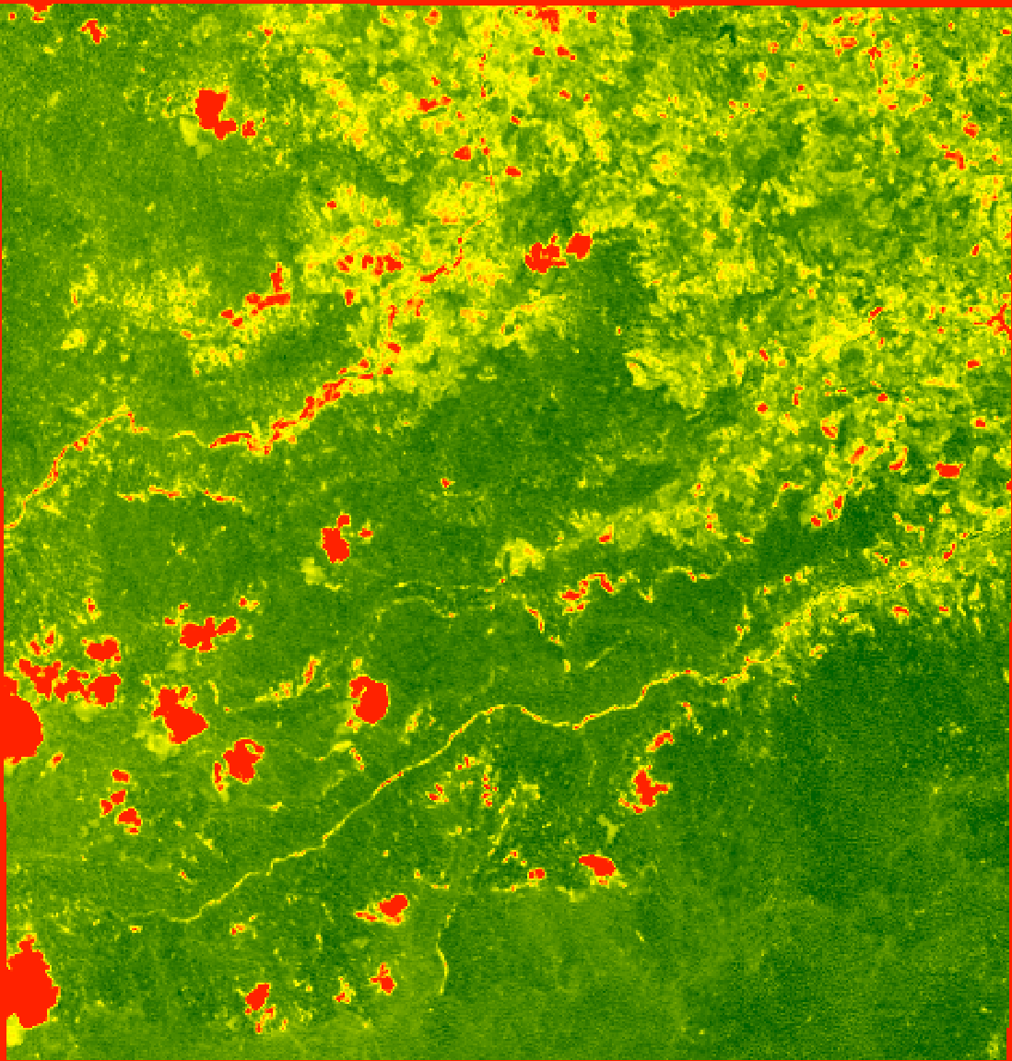
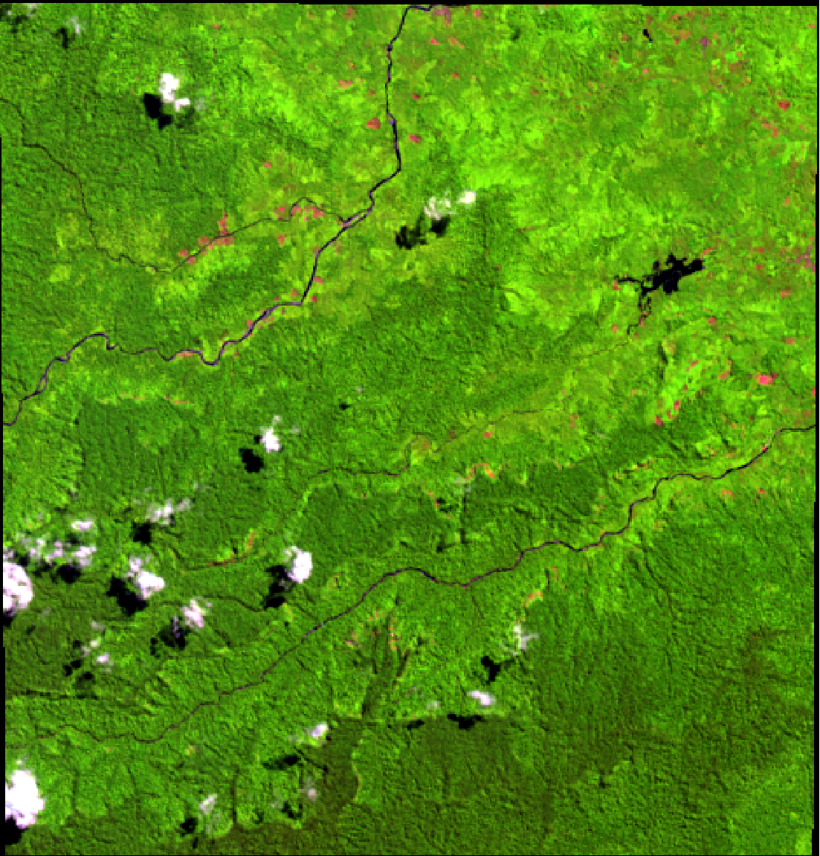
Model Applied to Estimate Canopy Cover in Mountain Ecosystem

Slide 16
Comparison of FRCI Actual and Prediction
RMSE: 0.275

Slide 17
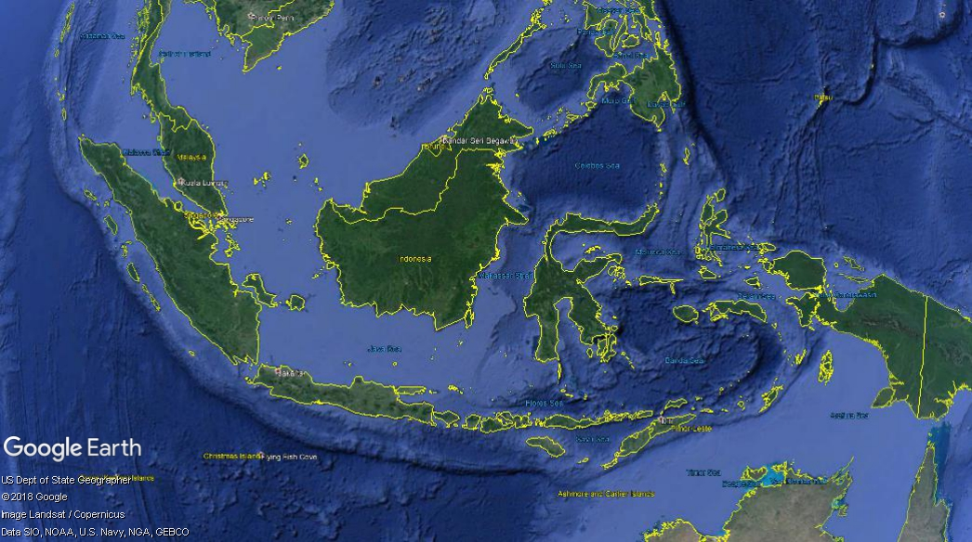
What Next?
The algorithm will be implemented into LAPAN’s system to estimate Forest Canopy Cover in National Scale

